Slide 1
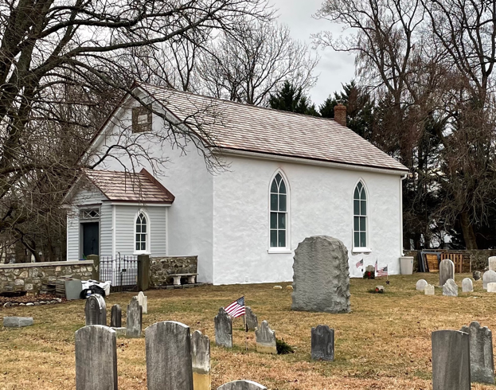
Newark Union Church & Cemetery
8 & 20 Newark Union Public Road, Wilmington, DE 19803
Delaware 1st State Cemetery Association meeting
October 18, 2024
Newark Union Corporation
October 18,2024

Slide 2
Slide 1 – Good Morning. Thank you for the opportunity to
present the Newark Cemetery to you. My name is Anne Daly
and with me is Cindy Davis. We are the Treasurer and Secretary,
respectively, of the Newark Union Corporation, which has a
nine-member Board of Directors that oversees the Newark
Union Church & Cemetery properties. The 2 properties are
so interconnected that a presentation of the Cemetery has to
include some facts about the Church.

Slide 3
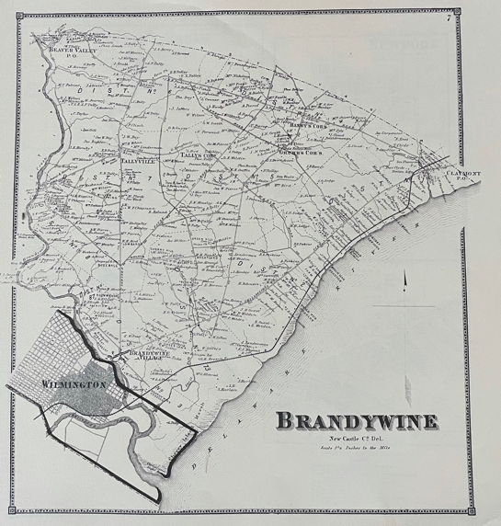
Newark Union Church & Cemetery… ...It’s not in Newark ! It’s in Brandywine Hundred.
Brandywine Hundred
Atlas of the State of Delaware, Pomeroy & Beers, 1868, page 7
October 18,2024

Slide 4
Slide 2 – First, I need to let you know that the Newark Union
Church & Cemetery is NOT in Newark. It is in Brandywine
Hundred, north of Wilmington. Using this 1868 Beers Atlas
map to orient you, this is Concord Pike/Rt 202. I-95 is about
here with the Marsh Road exit about here. The property is not
too far off the Marsh Road exit of I-95.

Slide 7
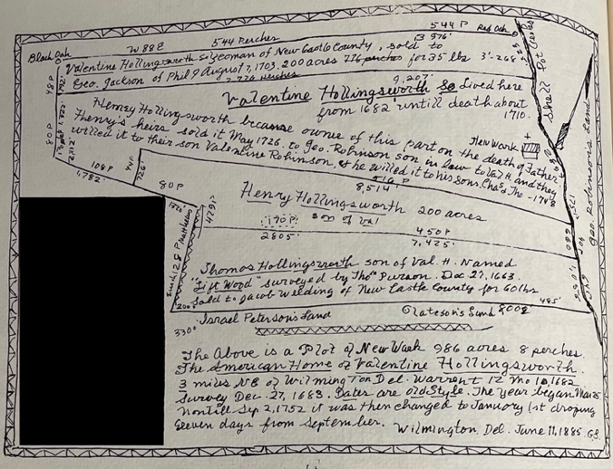
In 1682, Valentine Hollingsworth received a land grant
of 986 acres from William Penn.
North from Wilmington By Oulde Roades and Turnpikes,
Sawin & McEwing, pg 32
October 18,2024

Slide 8
Slide 3 – The properties are part of a land grant of 986 acres
that Valentine Hollingsworth, an Irish Quaker, received from
William Penn in 1682. This is a depiction of the property which
extends along the Shellpot Creek on the east, north to the
Red Oak and west to the Black Oak. This is where Rt 202,
Concord Pike is now located. The Newark Union Cemetery is
shown here.

Slide 9
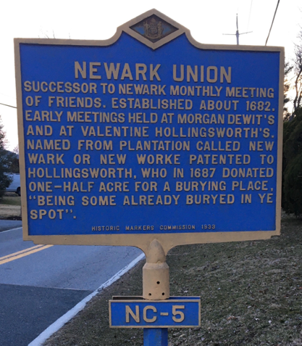
Hollingsworth’s Plantation
New Wark
New Worke
New Ark
Newark
Union = Community
October 18,2024

Slide 10
Slide 4 - The name, Newark, came from Hollingsworth who
named his original plantation New Wark. The name morphed
into New Worke and eventually Newark. This information is
given on the historical marker located near the stop sign at the
intersection of Newark Union Public Road and Baynard
Boulevard. The marker was placed in 1933 and is the fifth
historical marker to be placed in New Castle County. It’s a
historic landmark itself!

Slide 11
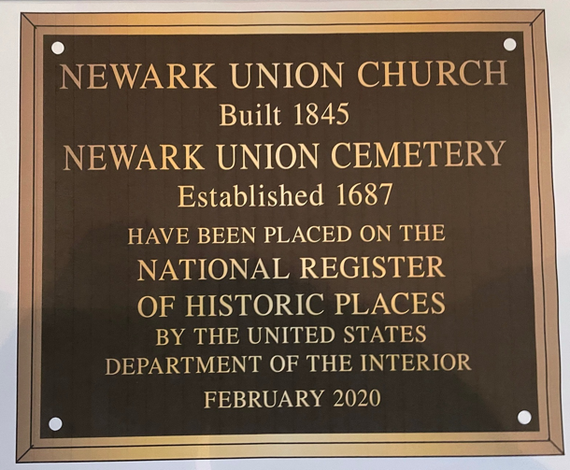
Newark Union Church & Cemetery Listed on the National Register of Historic Places in February of 2020
Center for Historic Architecture & Design, University of Delaware
Andreya Mihaloew, Michael Emmons, Catherine Morrissey
October 18,2024

Slide 12
Slide 5 – After research conducted in 2019, the Center for
Historic Architecture and Design from the University of
Delaware submitted the nomination packet for the Newark
Union Church & Cemetery to be placed on the National
Register of Historic Places. That position on the registry
was granted in February 2020.

Slide 13
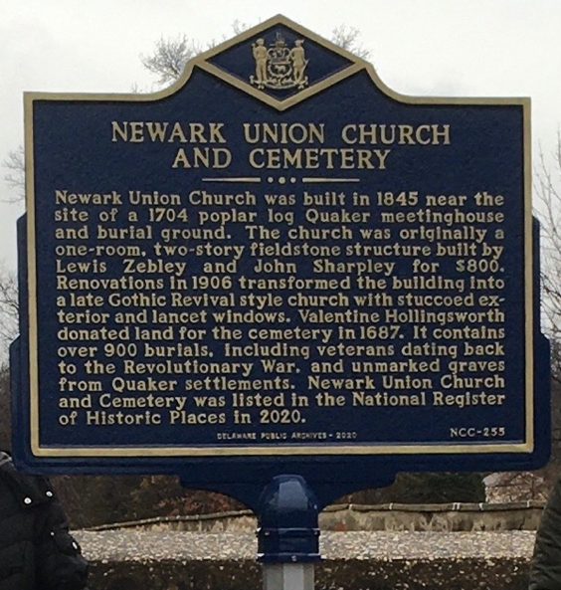
New Historical Marker acknowledging both
the Church and the Cemetery was installed
and dedicated in December 2020.
October 18,2024

Slide 14
Slide 6 – Later that year, a second historical marker was
placed close to the shared corner of the church and cemetery
properties.

Slide 15
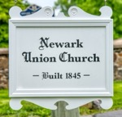
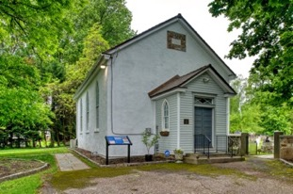
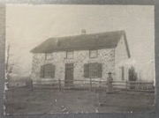
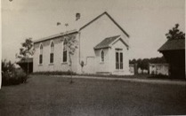
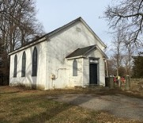
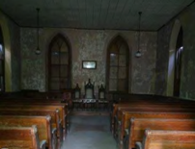
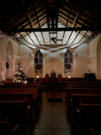
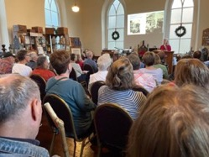
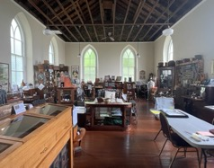
Newark Union Church
1845
Date Stone
1906
2020 - Before Restoration
2022 - Worship
Community Meetings
Displays
October 18,2024

Slide 16
Slide 7 - The Newark Union Church is such a historically significant part of the site that
I must take a few moments to share about it. The church was built in 1845 as a two-story
fieldstone Quaker meeting house. The Union, or community, met there on Saturdays for
exchange of goods and socializing, and then for worship on Sundays. By 1880, the Quaker
meeting had been “laid down” and the congregation of the church was Methodist,
although the church still belonged to the Union.
In 1906, the building was renovated to a Gothic Revival-style 1-story church with a
stuccoed exterior, large lancet windows and a separate entrance and foyer. The
Methodist congregation continued to worship there until 1951. That congregation
outgrew the church and built a new building along Concord Pike, which is Aldersgate
Methodist Church. A non-denominational congregation worshipped in Newark Union
Church until 1970 when they dedicated their new church building as the Shellburne
Bible Church located just down the hill. After that, the Newark Union Church building
was closed and remained vacant for over 50 years.
In 2020, with a rekindled vision, the Board of Directors began restoration of the church
to again open it up to the community for worship, weddings, funerals and community
meetings. With grants and generous individual donations, in 2021, the exterior was
restored. In 2022, after receiving additional grants and donations, the restoration of
the interior was completed. That year, the Shellburne Bible Church congregation
conducted a beautiful Christmas Eve worship service in the Church. In 2023, the
building was made available for community meetings. The Brandywine Hundred
Historical Society has been holding monthly meetings there with presentations of
historical focus. That Spring, a small wedding was held. Currently, the church holds
museum-quality displays highlighting times of the veterans in the cemetery and life
in the mid-to-late 1800s and early-1900s. Just last month, the Church had the honor
of being the place for a funeral service for one of the former caretakers of the property.
That brought the life of the church back to its original design and intent.
We will be holding a Grand Opening of the Church with its spectacular displays
in the Spring of 2025.

Slide 17
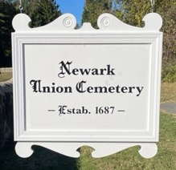
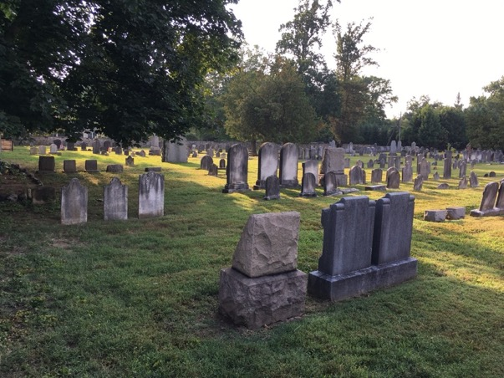
One-half acre was donated by Valentine Hollingsworth in 1687.
The cemetery was expanded in 1897 when additional acreage was purchased
from Clark Webster for $500 from the will of Rebeca Forwood.
The cemetery has over 1100 burials dating back to the late 1600’s.
Many prominent families of Brandywine Hundred are resting here; Talley,
Weldin, Carr, Grubb, Wilson, Miller, Sharpley, Foulk, Forwood and more.
October 18, 2024

Slide 18
Slide 8 – Newark Union Cemetery was established in 1687 by
Valentine Hollingsworth who donated the first half-acre of land
“being some already buryed in ye spot”, as indicated on the NC-5
historical marker. In 1897, additional ground was purchased. The
Cemetery now covers almost 2 acres, contains more than 1100
graves and is still active with 3-4 burials per year. It was defined
in the 1905 Articles of Incorporation that to be buried here, you
must be a resident of Brandywine Hundred or a family member
thereof, so you will find members of prominent Brandywine
Hundred families resting there.
This is a Perpetual Care cemetery. Burials are free but a Perpetual Care fee is charged. The fee used to be charged yearly but now there is only a 1-time fee when a plot is reserved.

Slide 19
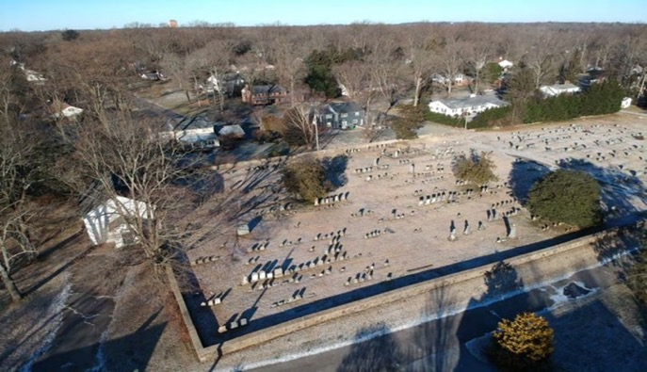
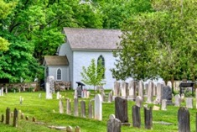
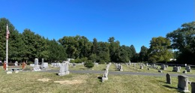
Newark Union Cemetery
NRHP Nomination packet
2019
South View
North View
October 18, 2024

Slide 20
Slide 9 – This is an aerial view of the cemetery taken in 2019. There is a driveway in the center and a fieldstone wall all the way around the perimeter. This area to the South is what we call the Old Section with the oldest burials closer to the stone wall. Current burials are handled in the New Section, to the North.

Slide 21
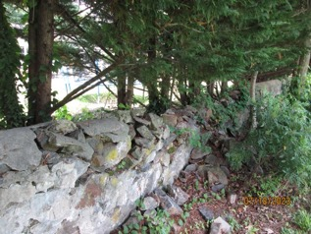
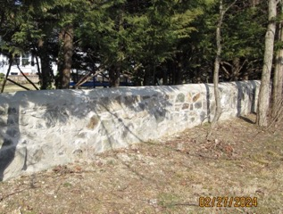
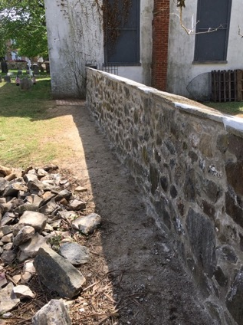
Cemetery Wall Restoration
Before
After
Distressed Cemetery Fund
Community Reinvestment Fund
October 18, 2024

Slide 22
Slide 10 – With grant awards from the Distressed Cemetery Fund and the Community Reinvestment Fund, 95% of the stone wall around the perimeter of the cemetery has been repaired and repointed.

Slide 23
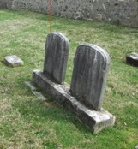
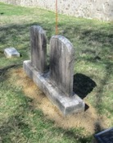
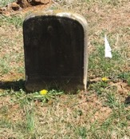
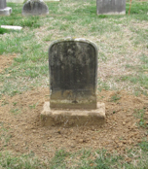
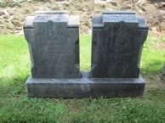
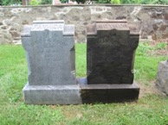
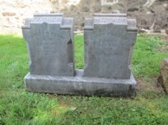
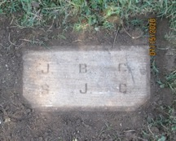
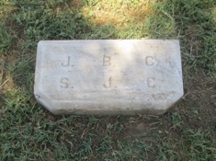
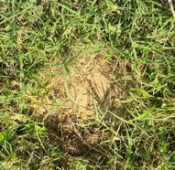
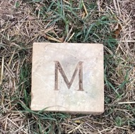
Headstones, Footstones, Corner Markers
Distressed Cemetery Fund
2 Eagle Scout Projects
October 18, 2024

Slide 24
Slide 11 - With several more grants from the Distressed Cemetery Fund and efforts from 2 Eagle Scout projects, over 225 headstones, footstones and corner plot markers have been raised, repositioned and/or repaired and cleaned.

Slide 25
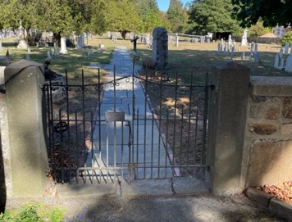
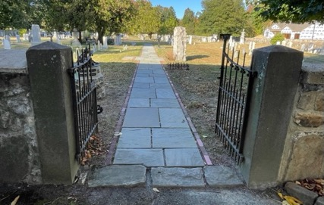
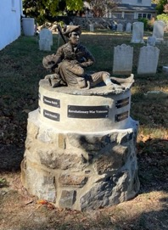
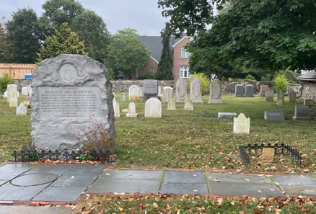
Welcome to the Newark Union Cemetery
Through the
Draper Gate
Valentine Hollingsworth memorial and original gravestone.
October 18, 2024

Slide 26
Slide 12 – So let me take you on a stroll through the Newark Union Cemetery.
As you walk through the gate installed in memory of Lawson Draper, on your left, you’ll see a statue entitled “The Patriots”. It was sculpted and donated by John DiMao and placed on a pedestal constructed by our stone masons, Will Nichols and Jimmy Baird.
On your right, you’ll see a huge monument. In 1935, descendants of Valentine Hollingsworth placed a memorial to him near the south entrance of the cemetery. Using Delaware Geneological Society records compiled in 1979, the actual location of Hollingsworth’s original gravestone was found. That stone has been raised and its position highlighted.

Slide 27
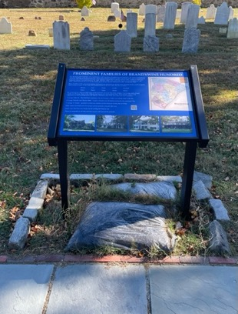
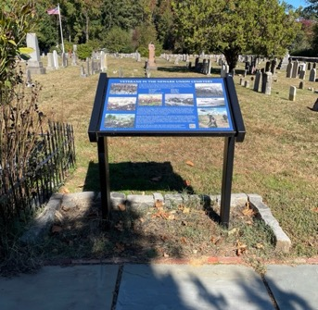
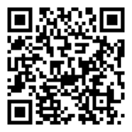
Interpretive Exhibit Signs
October 18, 2024

Slide 28
Slide 13 – Further down the walkway is one of 3 Interpretive exhibits on the property. Two are in the cemetery. One discusses the prominent Brandywine Hundred family members who are laid to rest there. The other sign, further down the walkway, highlights our veterans. Each sign has a QR Code on it which will take you to a website to allow for a self-guided tour with respect to these two topics. The third sign is in front of the Church.

Slide 29
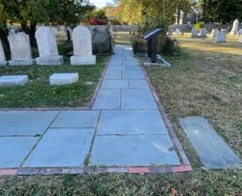
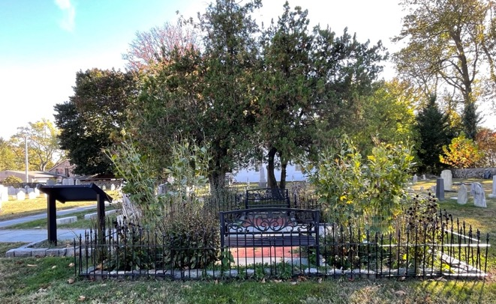
Victorian-style Memory Garden
October 18, 2024

Slide 30
Slide 14 – As you turn the corner of the walkway, you’ll see a garden. Volunteers have helped design and create a typical Victorian memory garden with benches and native plants, located under 2 old cedar trees in the old section of the cemetery. In Victorian times, when there were no public parks, after Church, folks would gather in cemeteries for picnics and visiting. Benches and small groups of plantings or shade trees would be throughout.

Slide 31
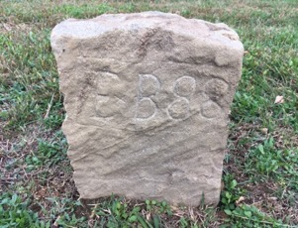
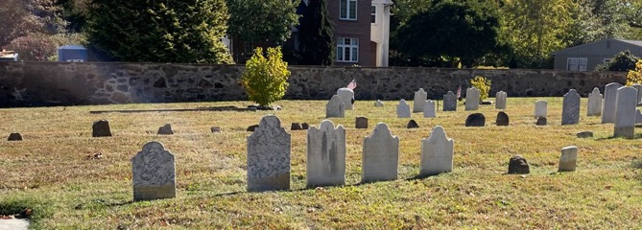
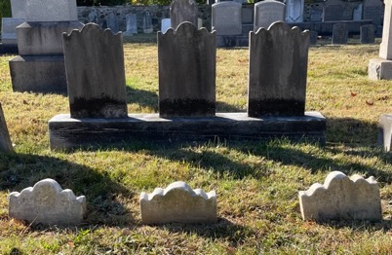
Two of the oldest dated Quaker grave stones in the cemetery:
“AB 1759” and “EB88”
Alice Beeson
Edward Beeson – son - 1788
Quaker stones and flat tablet headstones
Tablet headstones
with matching footstones
October 18, 2024

Slide 32
Slide 15 - The Newark Union Cemetery is a very unique place. With burials since the late 1600’s to some just this year, there are a vast array of tombstones.
The oldest dated stone is for Alice Beeson, 1759. Alice’s stone is right here and was above ground along with her husband’s stone. Completely underground but evenly spaced in alignment with those stones, were 9 others including one with “EB 88” engraved on it. We learned that was for Alice’s son Edward who died in 1788.
In that same area, many flat tablet headstones are present for the next years of burials. As time progressed, graves had smaller tablet footstones that reflect edthe shape of the headstone.

Slide 33
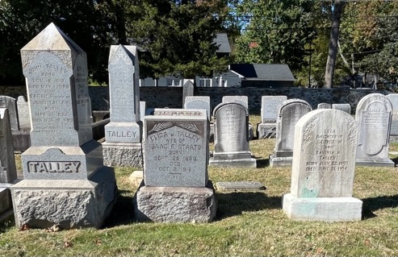
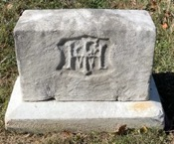
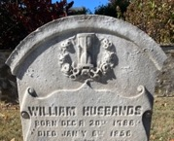
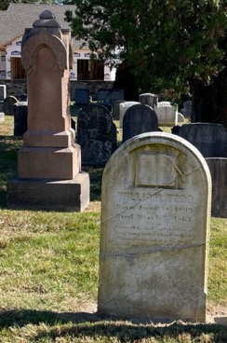
Influence of the Victorian Era
(1837-1901)
October 18, 2024

Slide 34
Slide 16 – Further into the cemetery, you can see the influence of the Victorian Era with elaborate stones and obelisks. Symbolism or monograms on the stones became popular. Here you can see an hour glass, a Bible, a hand pointing heavenward and a flower blossom that has wilted. A full blossom would be for an adult. An unopened blossom would be for a child.

Slide 35
Grave Guards Planted with Flowers
October 18, 2024

Slide 36
Slide 17 – Scattered around the cemetery are 6 graves with Grave Guards, also called Bedsteads. This arrangement was initially designed to provide protection for mounded dirt over a grave from being worn away but it became popular to provide for plantings of flowers, shrubs and vines and elaborate footstones. This one is for Willie Dempsey, the stillborn baby of John and Laura. This one is for Joseph Carr, a 26-year old young man who was killed in an accident. For the longest time, we didn’t know if the dog was a symbol of loyalty or represented a family pet. A family member visited and told us that the dog was also killed in the accident. This one was just found a few months ago. The Scouts found the side rails when they lifted the sunken footstone.

Slide 37
Memories
October 18, 2024

Slide 38
Slide 18 – From the old to the new, there are many examples of ways that families have honored their loved ones. The Baldwin memorial can hold fresh flowers. The Wilsons, known for their frequent cocktail parties, have a shiny black stone with engraved martini glasses. Susan Henzel was the piano player in the Newark Union Church when it closed and continued playing the piano in the Shellburne Bible Church. This owl sculpture, called Moonshine, was installed on the back of the memorial stone of Charles Allmond, a very talented sculptor.

Slide 39
Stories and Mysteries
October 18, 2024

Slide 40
Slide 19 – There are two lonely memorial stones are near the center of the cemetery. The large one is for Mytro Dobrisky. He was a Russian immigrant who worked on the nearby Buchannan Farm. One day, he was taking the 2 Buchanan children, a boy and a girl, for a horse-drawn carriage drive. In an accident at the railroad, all were killed, even the horse. The children were buried in the family farm plot. Other Russian immigrants paid for Mytro’s burial and monument.
Next to Mytro is Allen Sherod. He was an apprentice to a local craftsman. At the age of 19, he collapsed and died. It was determined that he had a brain tumor.
Young Franklin Jones loved cars and wanted to build a race car with his Dad. He was promised that would happen when he turned 16. Unfortunately, he passed away at the age of 15. His Dad gave him his race car on his memorial stone.
Under a huge azalea bush is the tombstone of Fred Clunie. Someday, we would like to learn who Deak was.
Although mostly tragic, we share these stories to keep the memories of these people alive.

Slide 41
Military Memorial
October 18, 2024

Slide 42
Slide 20 - There are 82 Veterans from the Revolutionary War through the Vietnam War laid to rest in the cemetery. Volunteers designed and installed a Military Memorial in the center of the cemetery. Included is a flagpole and American flag donated and installed by members of one of the prominent Brandywine Hundred families whose generations of ancestors rest in the cemetery. With a grant from the New Castle County Council Finance Committee, a memorial stone was added. This stone displays medallions of the 5 branches of the Armed Forces in which our veterans served.

Slide 43
Veterans from the Revolutionary War through the Vietnam War
Revolutionary War
War of 1812
Civil War
Spanish American War
October 18, 2024

Slide 44
Slide 21 – The Finance committee also provided funds for all of our veterans to be honored with an American flag and a medallion which represents the war in which they served. There are:
8 Revolutionary War veterans
3 from the War of 1812
6 from the Civil War
2 from the Spanish American War

Slide 45
Veterans from the Revolutionary War through the Vietnam War
World War I
World War II
Korean War
Vietnam War
October 18, 2024

Slide 46
Slide 22 -
9 from WW1 – 1 of which was a nurse
36 from WW2
12 from the Korean War
3 from the Vietnam war and
3 who served during non-war times.
Jacob Welding is the only veteran that was killed in action. He lost his life serving in the Vietnam War.
As we do more research and find obituaries, we think we will learn of a few more veterans.

Slide 47
Alexander Hand
First Delaware Recipient of the Medal of Honor
October 18, 2024

Slide 48
Slide 23 – Earlier this year, we had the honor to accept the placement of a memorial stone for Alexander Hand. He was the first Medal of Honor recipient in Delaware. He was awarded the medal for his bravery in the Navy during the Civil War. After his assignment in the Navy ended, he served several years in the Army. Alexander’s Father, Mother and 3 brothers are buried in Newark Union Cemetery but Alexander is not. After over 10 years of research by family members, the location of where he died and is buried was never determined. The family petitioned the Veterans Administration which provided the memorial stone for placement in the empty spot in the Hand Family plot.

Slide 49
2nd Saturday in December at 12:00 noon.

Slide 50
Slide 24 - The biggest event held yearly in the cemetery is the Wreaths Across America ceremony. This a national event held annually on the 2nd Saturday in December at 12noon. During this ceremony, each veteran is honored with a ceremonial wreath.

Slide 51
Thank you for strolling with me today!
Please come and visit the
Newark Union Church & Cemetery
8 Newark Union Public Road, Wilmington, DE 19803
Follow us on Facebook.
October 18, 2024

Slide 52
Slide 25 – As we close the gates to the side entrance of the cemetery, let me thanks you for allowing me to share the Newark Union Church & Cemetery with you today. If you are up our way, please stop by. My husband, Bob, and I live right across the street from the Church. And Cindy is only a few houses away. We’d be delighted to share more about the history of the site. And follow us on Facebook.

Slide 53
Newark Union Church & Cemetery
Acknowledgements
Gratitude
Preservation Delaware – Delaware Preservation Fund
Delaware Cemetery Board – Distressed Cemetery Fund
Crystal Trust Longwood Foundation Welfare Foundation
New Castle County Council Finance Committee Community Reinvestment Fund
Delaware Community Foundation Delaware 250 DE DoMore24
Cathy Cloutier George & Cindy Davis Harvey & Robin Day Bob & Anne Daly
John & Jo Hollingsworth Estate of Daniel Catherino
The Watson & Janet Day family Linda Weldin Emory & Stephanie Weldin Vandeguard
Artisans and Contractors and Consultants
RMV Electric Day-Light Electric Tim Carerre & Sons
Nichols Construction & Mason Contractors Baird Construction
Abba Monuments Pauley Memorials Cemetery Memorial Services
Premium Grade Cabinetry Brandywine Plaster
E. Baumann Contracting Longview Contracting
Bruce Hollingsworth Painting Michael’s Paving
New Life Furniture Solutions George Burns HVAC Larry Nagengast
Kim Burdick- Hale Byrnes House David Fleming – Fleming Consulting
Newark Union Corporation – Board of Directors
Bob Daly – President Anne Daly – Treasurer
Cindy Davis – Secretary Martha Weldin – Director
Janet Baumann – Director Jamie Campbell – Director
Gavin May – Director Patrick Kawka – Director
Lori Porter - Director (Joe Klusman – Past Director)
October 18,2024

Slide 54
Slide 26 - I would like to take a moment to acknowledge some of those who have supported the vision towards establishing the Newark Union Church & Cemetery as a historical landmark and to continue to honor those at rest there.
Thank you!

